Slide 1
Model
Read
ATGCCCACCGGAAGGTGCTGTCTGGGTTCATAA
M P T G R C C L G S *
ATGCCCACCGGAAGGTGATGTCTGGGTTCATAA
M P T G R * C L G S *
Model
Read
ATGCCCACCGGAAGGTGCTGTCTGGGTTCATAA
M P T G R C C L G S *
ATGCCCACC------------CTGGGTTCATAA
M P T L G S *

Slide 2
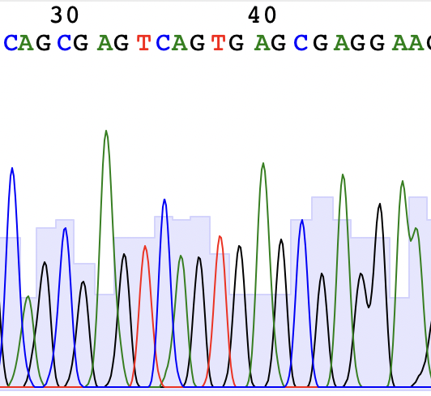
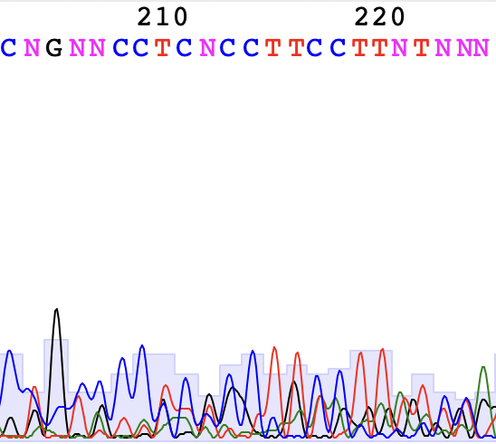
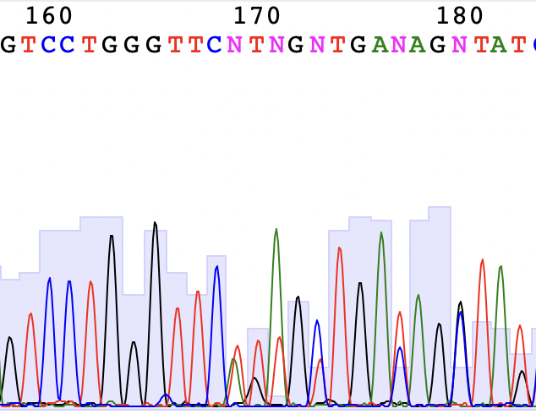
✅ High-Quality Read
⚠️ Low-Quality Signal
⚠️ Mixed Template
Two signals present

